Slide 1
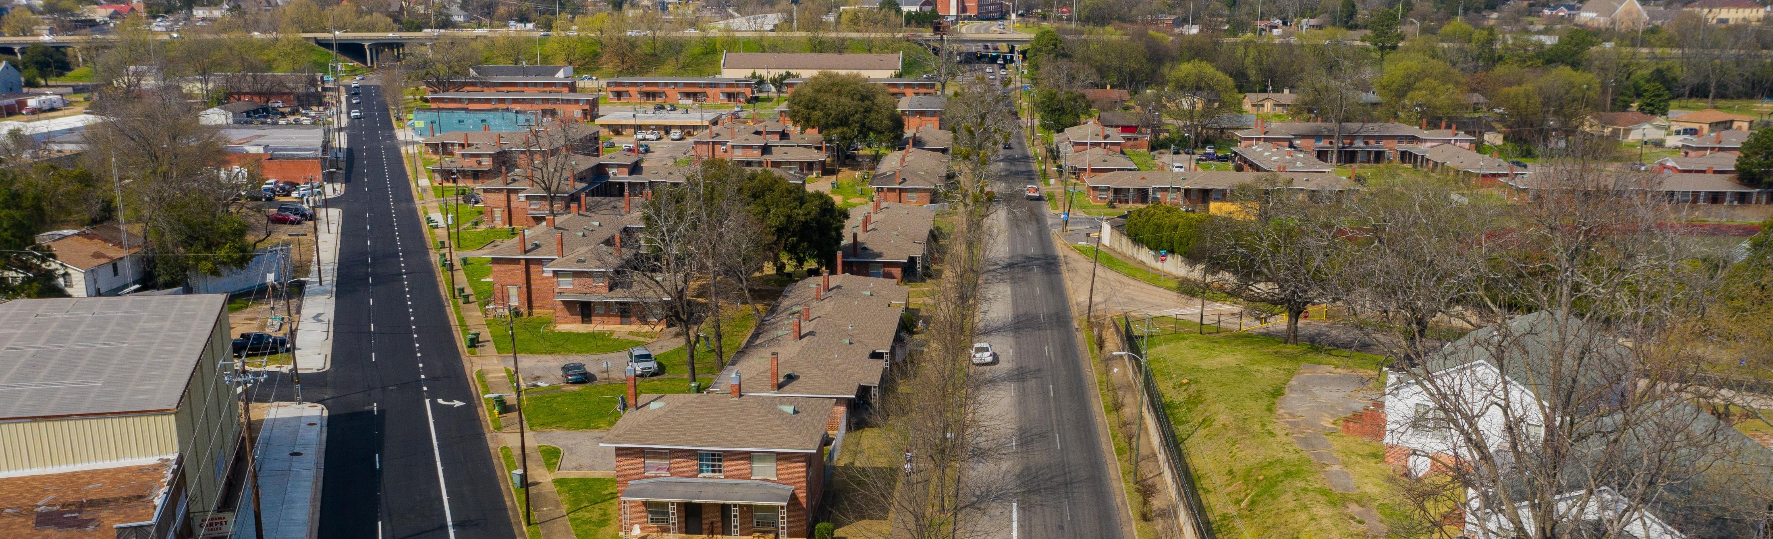
Deliverable: | What Partners Can Contribute:
Draft Transformation Plan | Ideas, Input, Review, Consideration, Collaboration, Team Building
Final Transformation Plan | Ideas, Input, Review, Consideration, Collaboration, Team Building
CNI Implementation Application $40M Application to HUD -2023 | Ideas, Input, Review, Consideration, Collaboration, Team Building and Leveraged Resources, Commitments
Partners are essential to the success of the CNI Implementation Grant. Therefore, we need you at the table with us!

